Slide 1

OnMyWay
Semester Project: Software Engineering
Presentation by:
Bushra Ahmad
Shahrukh Sultan
Master Group -6300
Date: 27th May, 2021
Under supervision of
Evgeny Filippov Ph.D.,
Associate professor
Alexander Eroshkin
Associate professor

Slide 2
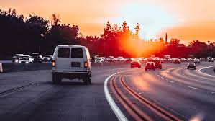
INTRODUCTION
The idea of the application and its main goal
You want to go from area to another in your country and you are alone at your car and you have a free seats .
Why you don’t take some people with you as a way of helping and kind of amusement.

Slide 3

My workplace is at the university and some of my neighbors also work at the university. How can I publish that I am going to the university today and I can take people with me
If this idea is implemented well, we can reduce traffic and reduce car fuel consumption

Slide 4
From these ideas emerged the idea of the application for us
Application for easy transport
OnMyWay

Slide 5
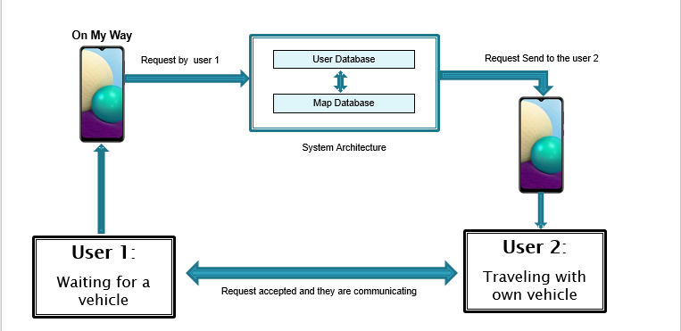
High level Architecture for our project

Slide 6
Detail requirements
Requirements:
Technologies used:
Flutter: To develop the application framework
Dart: To write the codes
API Server

Slide 7
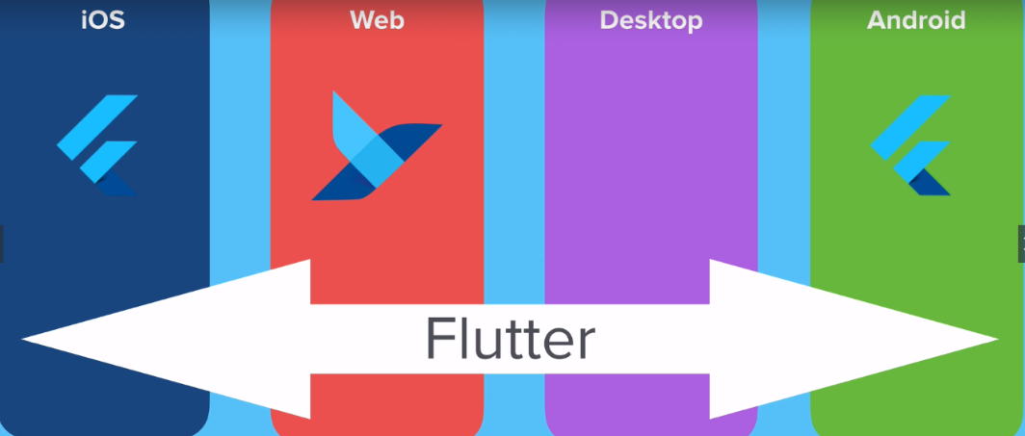
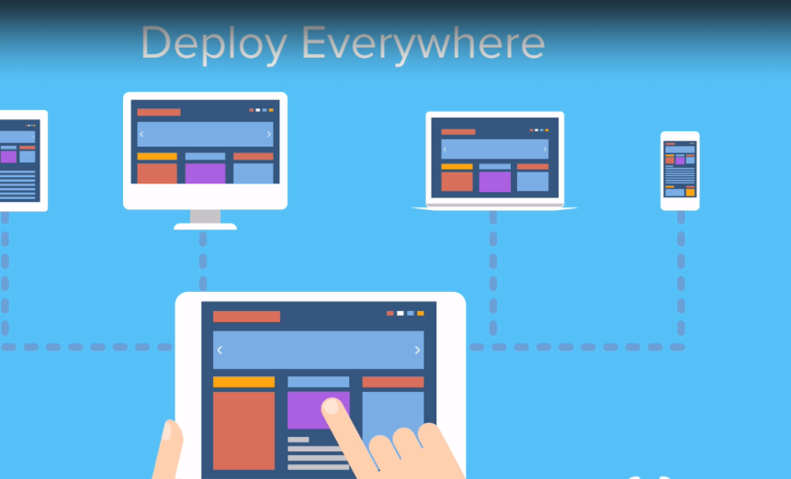
Flutter framework
Flutter is an open source software for a suite of software development tools developed by Google to build user interfaces for Android and iOS system applications.

Slide 8
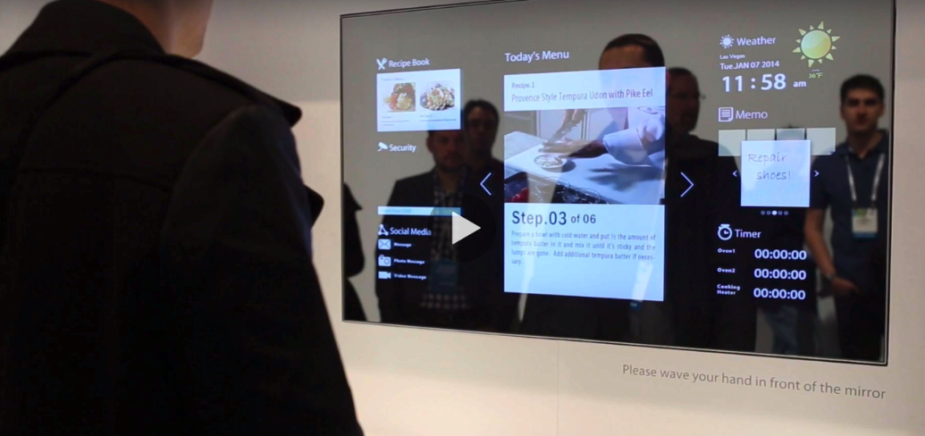
Why dart language ?
One of our aim in this course work is to learn Dart language for coding .
As we know this language :
1- A very flexible language in the sense that you can run it anywhere without any restrictions. You can run Dart applications. For mobile devices on Android - IOS.
You can run web applications that you create on any browser
2- Multi-platform.
3- under developing

Slide 9
DEMONSTRATION
Video 1

Slide 10
Video 2

Slide 11
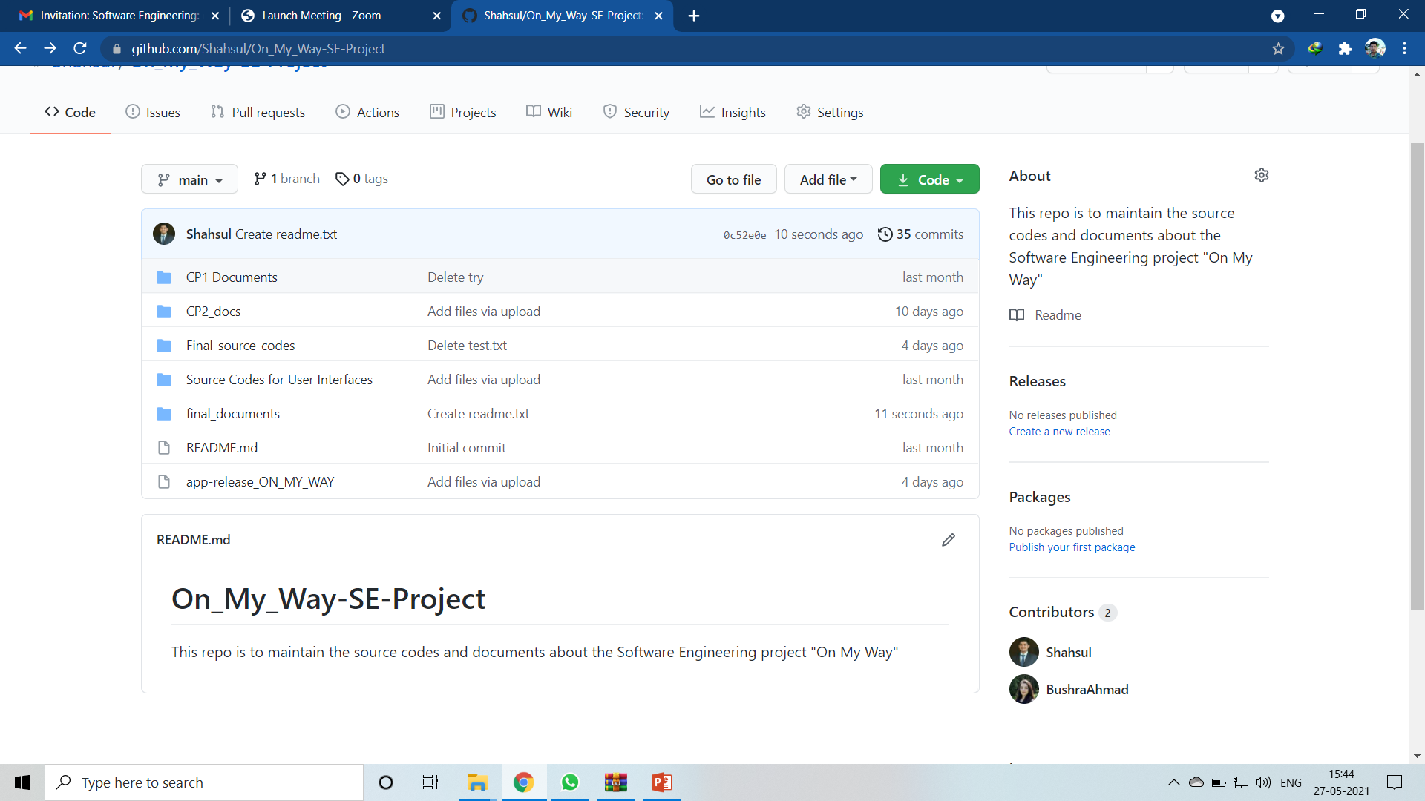
OTHER DETAILS:
Server: Microsoft Cloud Server
Configuration Management : GitHub
https://github.com/Shahsul/On_My_Way-SE-Project

Slide 12
Project Matrices
Total number of codes has increased above average during week 5 and till then it was mostly done.

Slide 13
Total number of bugs from starting to beginning is 86, 82 bugs are resolved and 4 bugs are still there.

Slide 14
Defect density is high during closing week as repeated testings were done at the end

Slide 15
Testing was done mainly by manual debugging and overall performance testing of prototype. Average efficiency is 86.2%

Slide 16
DEFECTS
Even when the user logs out from the application his sign in details is popped up in the screen, which is a security concern
When the user's internet connection is lost, the application does not warn the user about it
Sometimes seeked services is shown in the "provided services" tab
During registration or sign up the gender selection option takes only "MALE" as input, if someone selects "FEMALE" it doesn't work

Slide 17
Project Risks
Risk Description | Probability | Impact | severity | Manage the risk | Mitigating action
Due to lack of proper experience and expertise all the objectives is not achieved as expected earlier. | Medium | High | Medium | Project Developer | 1-Taking references from available resources 2- Consult some experts in this field
Due to slow processing of the windows PC the testing and overall development is not time effective | Low | Medium | Medium | Project Developer | Virtual system installation
The application may not be comfortable for all users due to lack of proper information about other end users | Medium | Critical | Medium | Tester | Setting a strong privacy policy

Slide 18
Individual Tasks and Achievements
Developers | Task | Total Hours Spent
Bushra Ahmad | Coding the user interfaces using dart language | 223
 | Preparing SOW, PMP and other reports
 | Testing
Shahrukh Sultan | Designing the architecture, Connecting to the server | 218
 | Preparing WBS and Project Matrices
 | Testing

Slide 19
Results and Conclusions
Result:
Well Implementation:
Attractive and easy user interfaces.
Main objective of the project is achieved.
Drawbacks:
Not enough information for user registration.
Service provider can’t know the information about service seeker.
There is no sufficient information for user authentication so other users may feel insecure to use the services.
The application is not tested for iOS devices due to lack of MAC device.
Future objectives:
Live tracing feature so that the service provider/service seeker user can trace each other live.
Setting more criteria for user authentication and safety.
Live notifications of services to users in a particular location.

Slide 20
Conclusions
During our work, we saw that every project starts with an idea and is being worked on and during this project journey you will face many challenges and new ideas that arise during the implementation of the project ,and the successful project gains its success from the accumulated experiences of its developers and their work to understand the shortcomings of the project

Slide 21
Thanks for listening

